Slide 1
université Constantine 01
faculté : des science exactes
Organe transplantation
Prepared by:
Bouazdia Maroua.

Slide 2
Plan:
Introduction and definition.
What organs to transplant !.
History and process.
The rejection of transplants.
Types of organe transplantation & Example.
Example.
BioEthics.
Algerian laws.
Religious side.
Gender transformation.
Conclusion and personal point of vue.

Slide 3
Introduction and definition of an Organ transplantation
Organ transplantation is a medical procedure in which an organ is removed from one body and placed in the body of a recipient, to replace a damaged or missing organ.
The person who receives the organ is called the recipient. The one who gives the organ is called donor, they may be at the same location, or organs may be transported from a donor site to another location.
removing an organ from a person's body and putting it into someone who may be very ill or dying. It can save the life of the person who receives the organ.

Slide 4
what organs to transplant?

Slide 9
How does organ rejection happen?.
Acute rejection – chronic rejection.
happens when your body's immune system treats the new organ like a foreign object and attacks it.
We treat this by reducing your immune system's response with medication.
you will need to take medication (immunosuppressants) for the rest of your life to keep your body from rejecting your new organ.
Is it possible to have another transplant if the first one fails?
• Most people can have a second, or even third, transplant.
• The wait for a second transplant is usually longer than for a first transplant.
• The success of a second transplant is, on average, as good as for a first transplant.

Slide 10
Types of organe transplantation

Slide 11
More to know about; Xenotransplantaion

Slide 12
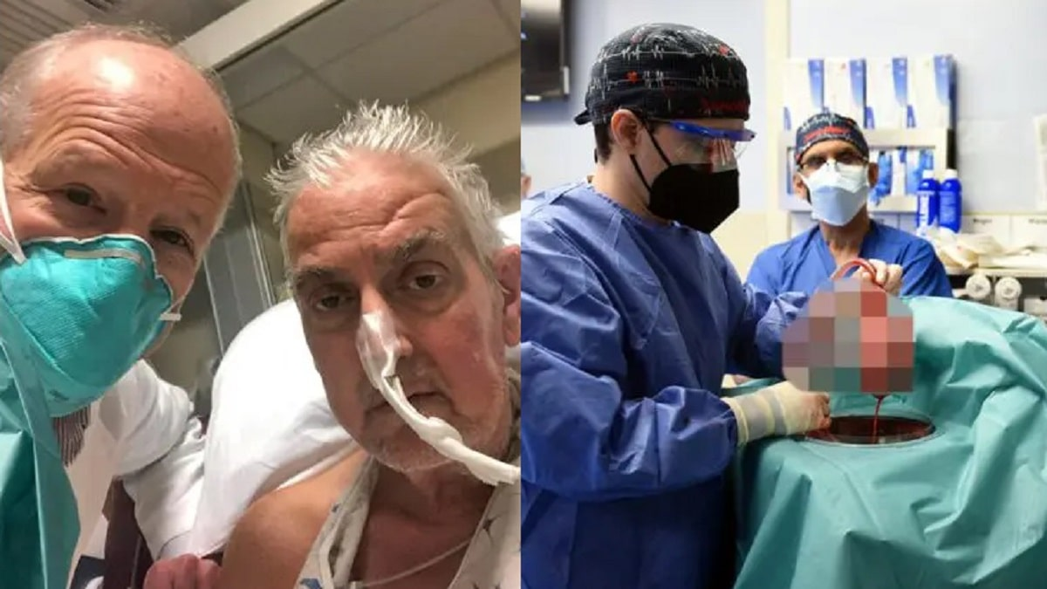
the Center for Innovative Medical Models (CiMM) in Munich affiliated with Ludwig Maximilians University, which is a unique research environment for generating animal models(a very special types of pigs).
The story of Mr. David Bennett
David Bennett is a 57-year-old American citizen. He has been suffering for years from a serious heart disease that requires a heart replacement operation,he has been bedridden for 3 months, waiting to die. he did not qualify for a human heart transplant, so he decided to undergo an experimental test. Completely new of its kind, it receives.He says: “Either I die, or I do this transplant.” I want to live.
He experienced strong cardiac function with no obvious signs of acute rejection for nearly seven weeks after the surgery. A sudden onset of heart failure led to his death two months after the transplant.
The operation was performed January 2022, at the American University of Maryland Hospitals, and the US Food and Drug Administration granted emergency authorisation. It wasn't just an ordinary pig heart, it received 10 genetic modifications.

Slide 13
In China, researchers transplanted insulin-producing pancreatic cells from genetically modified pigs into the bodies of diabetic patients.
At Massachusetts General Hospital in America, researchers announced last October that they had used genetically modified pig skin as a temporary wound covering for a person with severe burns. It worked as effectively as human skin, better than any other animal’s skin.
pig valves are already being used successfully in Current heart operations.
There are multiple reasons that make pigs the best organ donors. Pigs have been well studied over many years from physiological and anatomical aspects. They are also relatively easier to genetically modify.
pig organs are similar in size and anatomical structure to human organs, so it make it easier to place them, and in each "belly" They produce a large number of offspring (like rabbits), and they reach adulthood in about six months,

Slide 15
ethical issues
Recipient-related issues
Selection: Selecting the most suitable recipients for organ transplantation is essential to maximize the success of the procedure and utilize donor organs effectively. Factors such as medical urgency, transplant urgency, and long-term survival potential are considered during recipient selection.
Informed consent: Recipients must be fully informed of the risks and benefits of transplantation, including the potential for rejection, the need for lifelong immunosuppressive drugs, and the possibility of side effects from these drugs.
Donor-related issues
Consent: Obtaining informed consent from both living and deceased donors is crucial. Living donors must be fully informed of the risks and benefits of donation, while consent from deceased donors may be obtained through proxy consent or implied consent laws.
Allocation: The allocation systems are used to ensure fair and equitable access to organs while considering factors such as medical urgency and transplant urgency.
Societal issues
Commercialization: The commercialization of organ transplantation raises ethical concerns, particularly regarding the potential exploitation of vulnerable populations and the creation of an organ market.
Xenotransplantation: Xenotransplantation, the transplantation of organs from animals to humans, raises ethical concerns regarding animal welfare, the potential for cross-species disease transmission, and the social acceptability of such procedures

Slide 16
Autonomie – Beneficence/ non maleficence – justice:
Organs should be removed from deceased persons for the purpose of transplantation if the consent recuired by low is obtained or he did not objected such removel during his lifetime.
Living donors should be genetically, legally emotionally related to their recipients. Informed consent not by force not for the reward of money.
No organs should be removed from minors and legally incompetant people for the purpose of transplantation.
Cells and tissues, organes should only be donated freely without any monetary payment or reward of money.
This should be guided by clinical criteria and ethical norms not financial.

Slide 18
This activity of organ harvesting and organ transplantation is governed by Law 85-05 of February 16, 1985 and the various implementing regulatory texts.
This activity can only be practiced in authorized establishments (order number 29 of June 14, 2012 supplementing order number 30 of October 2, 2002).
The removal of organs from deceased persons can only be carried out after medical and legal confirmation of death and if the deceased did not object to the donation during his lifetime.
Organ harvesting from living people can only be carried out on adults and must not endanger the life of the donor. Consent must be free and informed.
Free donations .The absence of remuneration for graft removal procedures.
Anonymity is mandatory.
This concerns leads to the need to create and establish specialized centers for human organ transplantation supervised by the state whose services have to be extended to include poor people, thing that was translated into practice in Algeria through the establishment of the National Agency of Organ Transplantation and its management under the executive decree 12/167 of Jumada 13th, 1433 corresponding to April 5th, 2012

Slide 19
Religious side

Slide 20
Judaism
Cristianity
The cristian church encourages organ and tissue donation, stating that: « Individuals were created for God’s glorry and for sharing of God’s love »
According to Matthew 10:8, Jessus said « to heal the sick … Freely you have received, freely give ».
Saving lives and healing those who are suffering is a gift of love, and donating organs is one way to heal the lives of many others.
Judaism sanctions and encourages organ donation in order to save lives.
Judaism holds that organs can not be removed from a donor until death is confirmed.
The diagnosis of death using neurological criteria known as brain stem death is acceptable.
Many families who agree to organ donation have said that it helps to know some good has come from their loss

Slide 21
Islam
Accordingly, some may believe that organ transplantation/donation is prohibited; however, several Islamic jurisprudential principles have allowed others to determine its permissibility including
(1)necessity-breaks-the-law (darūra);
(2) working for the public interest or wellbeing of society (al-masalih al-mursalah);
(3) altruism (al-ithar).
Darūra may allow for exceptions to general rules.
Disagreements exist regarding transplantation fatawa. 23 were Sunni (13 permissible, 7 conditional, 3 prohibited)
قوله تعالى " ومن أحياها فكأنما أحيا الناس جميعاً" المائدة 32 .
وقوله تعالى: " يريد الله بكم اليسر ولا يريد بكم العسر" البقرة 186

Slide 22
Gender transformation and Sexual enhancement
This surgeries are only an apparent change.These operations are forbidden by law, because they involve changing God’s creation and deviating from nature. These operations are not permitted except for someone whose condition is suspicious. The operation is performed on him to return to his natural state. If your genitals are normal and there is no doubt, then it is not permissible for you to undergo sex reassignment surgery, and your psychological inclination does not permit this operation to be performed.Despite recent biological and clinical developments, genital transplantation remains experimental, controversial, and rejected by many societies because it alters nature and causes problems such as deceiving the other world in a way that contradicts biological reality.

Slide 23
Conclution and personal point of vue
Transplantation, the last resort in the event of failure of a vital organ, remains a cumbersome operation and a race against time. The control of the recipient's immune reaction against the graft has made serious progress, so much so that in the short term, the risk of rejection is now under control
Transplantation saves a lot of people around the world, it is a way of contributing to the rescue of people suffering from illnesses or who have suffered serious injuries. It is a way to show the generosity of donors for recipients.
But each person is free not to donate his organs while alive to avoid suffering after the donation and to keep The sanctity of his body. For people who’s rejecting donation after their death, they just have to know more about the benefits and how can he be a reason of saving a life and be able to make his Dua and wished come true. and how good it feels to know you’re the reason that a person had another chance to be with his familly and friends and he got rid of the pain and suffer. Qfter all if he still reject donation he’s free.

