Slide 1
Bioethics presentation on: Euthanasia
Ethics
By:
DIAF Loudjeine
FOUGHALI Nahla

Slide 2
Table of contents
Introduction | Definition and history of euthanasia.
Ethical perspective | Ethical and lelag codes in medical professions.
Religious perspective | Judaism, christianity, islam .
Further debates | Some arguments supporting/opposing the legalization of euthanasia .
Case studies | Dax Cowart, Dr Jack Kevorkian, Dr Nigel Cox, Miss B.
Alternative solutions | Some solutions .
Conclusion | Plus the personal position.

Slide 3
01
Introduction

Slide 4
Euthanasia has long been a subject of intense debate, encompassing moral, legal, and philosophical dimensions.
As we delve into the complexities surrounding this issue, it is crucial to approach the conversation with open minds, empathy, and a commitment to understanding the diverse perspectives that shape our understanding of life, death, and the inherent dignity that defines our shared humanity.
This presentation raises the debate on euthanasia and the issues related to it around the world.

Slide 5
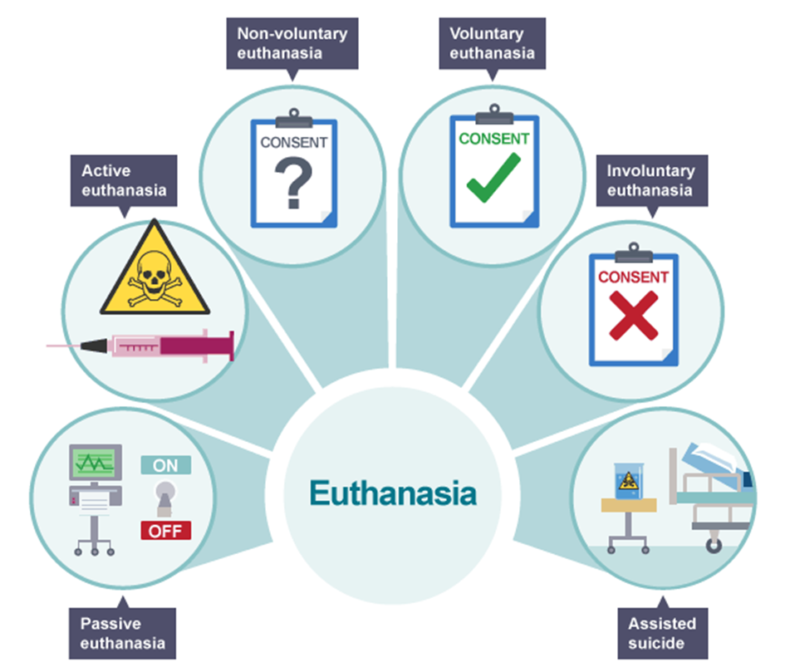
What is euthanasia?
Euthanasia comes from the Greek words ‘EU’ meaning ‘good’ and ‘THANATOS’ meaning ‘death’. Bringing these together, euthanasia means ‘the good death`
Classically, it’s defined as the hastening of death of a patient to prevent further sufferings.
It can also be defined as “the direct intentional killing of a person as part of the medical care being offered.“
Within this broad definition, there are several terms used to describe different forms of euthanasia:

Slide 6
History of euthanasia
In the early 1500s, the English thinker Thomas More introduced the term euthanasia in philosophy being a legitimate act in the case of incurable diseases, with the permission of priests and doctors.
By 1605, another philosopher, Francis Bacon, addressed the issue in modern cultures, arguing that the prolonging of life in cases of incurable sicknesses involves continued suffering for patients and families.
Euthanasia has made its way into psychology by 1920, in reference to the book ‘Allowing The Destruction Of Life Unworthy Of Living’ by Alfred Hoch, followed by the jurist Karl Binding who formulated the theory of euthanasia as a social remedy to the suffering of patients and the social and economic costs of the disease.
Only until 1998, the Code of Medical Ethics defined ‘therapeutic obstinacy’ as “Obstinacy in treatments for which there is no well-founded reason to expect a benefit for the patient’s health or an improvement in quality of life.”

Slide 7
Timeline of euthanasia
Countries
Netherlands (April 2002)
Belgium (May 2002)
Luxembourg (March 2009)
Colombia (December 2014)
Canada (June 2016)
Spain (june 2021)

Slide 8
Ethical perspective
02

Slide 9
Medical professions must follow both ethical and legal codes. Which raises questions like:
whether the physician, patient or relatives have the right to decide the application of euthanasia?
It is the final decision of an individual during the last stages of his/her life, so it is of importance to analyze the issues involved in legalizing euthanasia, so that it can be prevented from being abused.
If euthanasia is legalized then there may be a solution for the questions like whether the individuals or patients have the right to live or die?
But euthanasia, if legalized will be abused; if it is not legalized then the patient has to undergo continued sufferings?
Hence, there are ethical and legal dilemmas involved in legalizing euthanasia.
Conditions making the patient legitimate to his right to die:
The patient’s suffering is unbearable.
The disease is incurable and there is no chance for recovery.
The patient’s condition is terminal.
The Patient must express consent and request for death.
The physician must have ineffectively exhausted all other measures of pain relief.

Slide 10
Religious perspective
03

Slide 11
What do relligions say on this topic?
Beliefs in the Jewish faith
Beliefs in the Christian faith
Beliefs in Islamic faith
“My creatures need it [death].”
the prolonging of a life which is destined to end is a crime, it is up to the physician to know when to stop treatment so euthanasia is just.
"Thou shalt not murder"Life in Judaism is sacred, suicide is considered a great sin thus PAS is unjust.
"Or do you not know that your body is a temple of the Holy Spirit within you...therefore glorify God in your body."
With this quote we can say that human's life is seen as divine. The act of euthanasia is, then, as horrible as suicide, it is considered an immoral act.
” No fatigue, nor disease, nor sorrow, nor sadness, nor hurt, nor distress befalls a Muslim”
the right to die is not debated in Islam, whereas suicide is strictly forbidden, for no living being gets to play god and end a life before the time that Lord Almighty has appointed for them. The point of physician-assisted suicide is considered unjust.

Slide 12
04
Further debate

Slide 13
The debate over the legalization of euthanasia is multifaceted, involving considerations of ethics, individual rights, Public opinion and legal frameworks on euthanasia vary widely across different countries and regions.
Arguments in Favor of Legalizing Euthanasia
Arguments Against Legalizing Euthanasia
Individual Autonomy
Relief from Unbearable Suffering
Quality of Life
Reducing Burden on Families
Preventing Medical Overtreatment
Regulation and Oversight
Sanctity of Life
Slippery Slope
Medical Ethics
Potential for Abuse
Improvements in Palliative Care
Ethical and Moral Concerns

Slide 14
05
Case studies

Slide 15
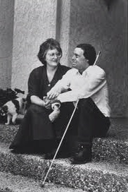
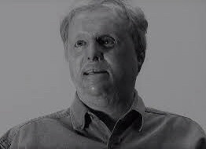
Dax Cowart
Miss B
Dax Cowart was very badly burnt after a gas explosion engulfed his car. He said “I was burned so severely and in so much pain that I did not want to live even in the early moments following the explosion.” Dax repeatedly asked his doctors, family and friends to help him end his suffering, which lasted through 10 years of agonizing treatment. Dax is blind and cannot use his hands, but is otherwise healthy and currently works as an attorney. He still believes it was wrong to deny his request for euthanasia.
A woman known as "Miss B", who was paralyzed from the neck down, died peacefully in her sleep on 29 April 2002 after winning the legal right to have medical treatment withdrawn.
Miss B had the "necessary mental capacity to give consent or to refuse consent to life-sustaining medical treatment". It was her decision, not her doctors, whether the ventilator which kept her alive should be switched off, in addition to drug treatment and care to "ease her suffering and permit her life to end peacefully and with dignity..

Slide 16
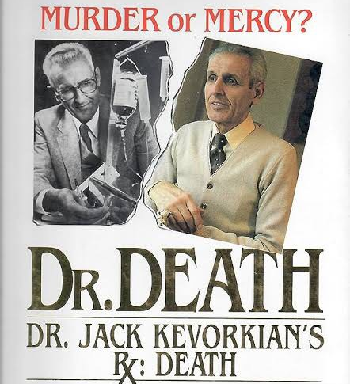
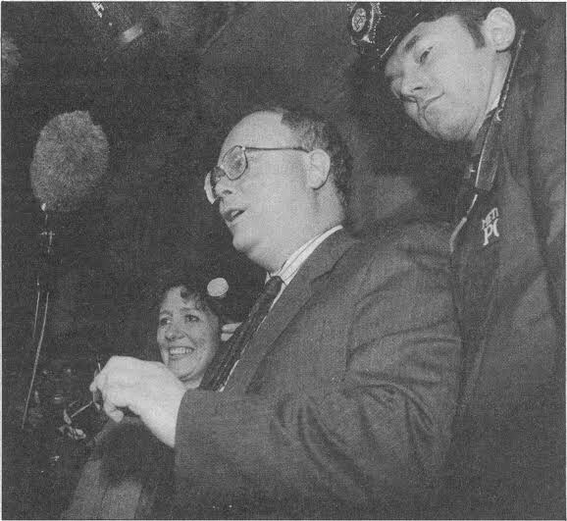
Dr Jack Kevorkian
Dr Nigel Cox
Kevorkian earned the name 'Dr Death' by photographing the eyes of dying patients. Later in his career, he began to advertise his services as a physician offering 'death counselling'. When terminally ill patients learned that he was helping people to die, more and more people came to him. Kevorkian helped over 130 people to die.
Kevorkian believed that helping people was not enough, and actually killed Thomas Youk, filmed himself doing so and showed the film on 60 Minutes. He left the studio in handcuffs, and, defending himself unsuccessfully in court, was sentenced to 10-25 years in prison.
Dr Nigel Cox remains the only doctor ever to be convicted in the UK of attempting to perform a mercy killing. A consultant rheumatologist from Hampshire, he was found guilty of attempted murder after injecting 70-year-old Lillian Boyes with a lethal drug.
Dr Cox's act was discovered by a nurse who read Miss Boyes medical notes. She realized that the potassium chloride he had used would not alleviate pain, but instead stop Ms Boyes' heart. The charge of attempted murder was brought because it could not be proved conclusively that the injection had killed her.

Slide 17
06
Alternative solutions
Ethics

Slide 18
These alternatives aim to emphasize compassionate care, relieve suffering, and honor the dignity of individuals at the end of life without resorting to euthanasia.
Improvement of Palliative Care, prioritize specialized care aimed at alleviating pain and improving the quality of life for individuals with serious illnesses.
Terminal dehydration. (The voluntary stopping of eating and drinking.)
Encouraging individuals to engage in Advance Care Planning to facilitate discussions and clarify healthcare preferences, goals, and values, allowing individuals to document their wishes through advance directives and living wills.
Improved Communication to foster open dialogue among healthcare professionals, patients, and families to ensure shared understanding and informed decision-making.
Psychosocial Support, Address emotional well-being through social workers, counselors, and support groups, acknowledging and managing psychological distress.
Establishing clear legal Ethical Frameworks that balance individual autonomy with the protection of vulnerable individuals, reflecting societal values.
Spiritual and Religious Support, Recognize the importance of faith in end-of-life care, providing access to chaplains or spiritual counselors.

Slide 19
02
Conclusion

Slide 20
In conclusion, the topic of euthanasia is complex and highly sensitive, involving profound ethical, moral, and legal considerations. As we navigate this intricate landscape, it is essential to approach the discourse with empathy, understanding, and a commitment to preserving human dignity.
Whether one supports or opposes euthanasia, the key lies in fostering open dialogue, encouraging informed decision-making, and striving to find compassionate solutions that uphold the sanctity of life while respecting individual autonomy.
Ultimately, the exploration of euthanasia prompts us to reflect on the values that define our society and challenges us to seek a balance that aligns with our collective sense of humanity and compassion.

Slide 21
Thank you for your attention!

