Slide 1
University of the Fraternity Mentouri Constantine 1
biomedical ethics
Bioethics
Mennai imad
Eulmi nacerreddine chahinez
Brahimi djihane
year
2023/2024

Slide 2
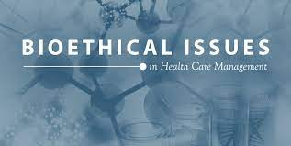

Slide 3
PLAN
INTRODUCTION
BIOETHICS
History
The four pillars of medical ethics
Beneficence
Why Is Beneficence Important?
Non-maleficence
How Is Non-Maleficence Different to Beneficence
Autonomy
Why Is Patient Autonomy Important
Justice
Opinion of religions
The opinion of Islam
The opinion of the Jews
Example
Conclusion

Slide 4
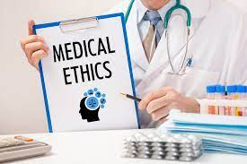
introduction
Medical ethics is an applied branch of ethics which analyzes the practice of clinical medicine and related scientific research. Medical ethics is based on a set of values that professionals can refer to in the case of any confusion or conflict. These values include the respect for autonomy, non-maleficence, beneficence, and justice.

Slide 5
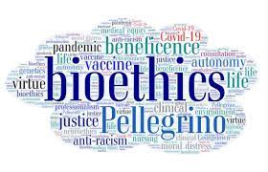
Bioethics
is both a field of study and professional practice, interested in ethical issues related to health (primarily focused on the human, but also increasingly includes animal ethics), including those emerging from advances in biology, medicine, and technologies. It proposes the discussion about moral discernment in society (what decisions are "good" or "bad" and why) and it is often related to medical policy and practice, Bioethics is concerned with the ethical questions that arise in the relationships among life sciences, biotechnology, medicine, politics, law, theology and philosophy. It includes the study of values relating to primary care, other branches of medicine , ethical education in science, animal, and environmental ethics, and public health

Slide 6
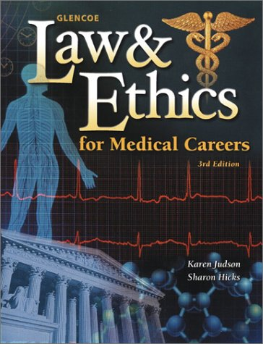
History
There are several codes of conduct. The Hippocratic Oath discusses basic principles for medical professionals.
This document dates back to the fifth century Both The Declaration of Helsinki (1964) and The Nuremberg Code (1947) are two well-known and well respected documents contributing to medical ethics.

Slide 7
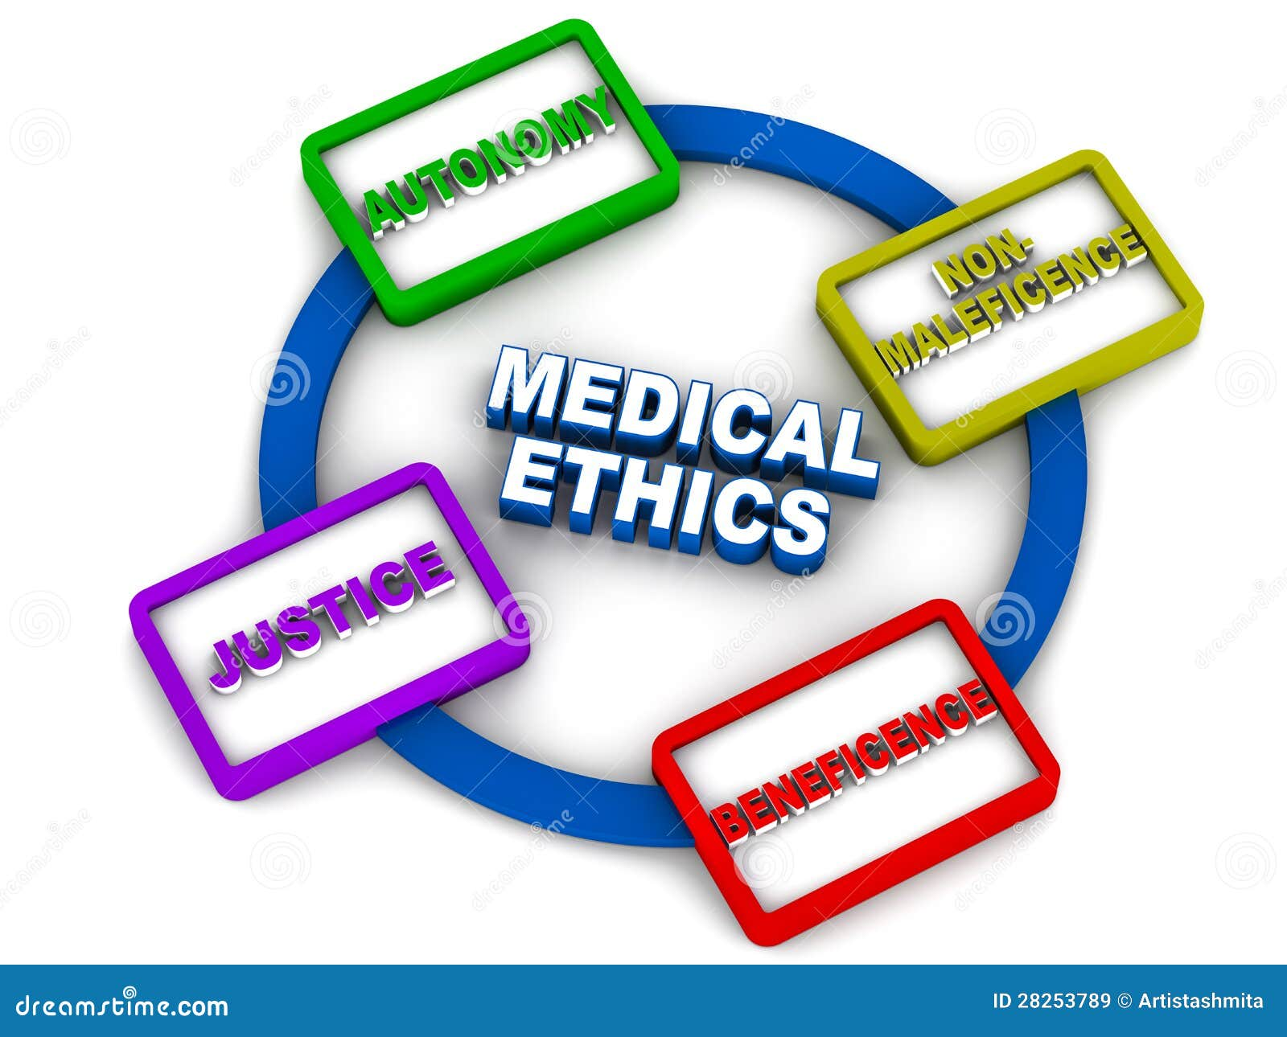
Pillars of Medical Ethics
The four pillars of medical ethics are:
1*Beneficence (doing good)
2*Non-maleficence (to do no harm)
3*Autonomy (giving the patient the freedom to choose freely, where they are able)
4*Justice (ensuring fairness)

Slide 8
Beneficence
Beneficence means that all medical practitioners have a moral duty to promote the course of action that they believe is in the best interests of the patient.
It’s better to think of beneficence as the process of ranking the available options for the patient from best to worst, taking into consideration the following aspects:
Will this option resolve this patient’s medical problem?
Is it proportionate to the scale of the medical problem?
Is this option compatible with this patient’s individual circumstances?
Is this option and its outcomes in-line with the patient’s expectations
of treatment?
Why Is Beneficence Important?
Beneficence is important because it ensures that healthcare professionals consider individual circumstances and remember that what is good for one patient may not necessarily be great for another.

Slide 9
Non-Maleficence
Non-maleficence states that a medical practitioner has a duty to do no harm or allow harm to be caused to a patient through neglect. Any consideration of beneficence is likely, therefore, to involve an examination of non-maleficence.
How Is Non-Maleficence Different to Beneficence?
Non-maleficence differs from beneficence in two major ways.
First of all, it acts as a threshold for treatment. If a treatment causes more harm than good, then it should not be considered. This is in contrast to beneficence, where we consider all valid treatment options and then rank them in order of preference.
Second, we tend to use beneficence in response to a specific situation – such as determining the best treatment for a patient. In contrast, non-maleficence is a constant in clinical practice. For example, if you see a patient collapse in a corridor you have a duty to provide (or seek) medical attention to prevent injury

Slide 10
Autonomy
In Medicine, autonomy means that a patient has the ultimate decision-making responsibility for their own treatment. A medical practitioner cannot impose treatment on a patient. The only exception is in cases where the patient is deemed unable to make autonomous decisions
The principle that a patient has the right to choose what happens to their body seems pretty straightforward
Even today, some patients defer all decision-making to the “wise Doctor” – even if they do not feel comfortable with their treatment plan.
Why Is Patient Autonomy Important?
Autonomy is important because we need to make sure that the patient is actively involved in their diagnosis and treatment – and not just deferring to their Doctor.

Slide 11
Justice
Justice – in the context of medical ethics – is the principle that when weighing up if something is ethical or not, we have to think about whether it’s compatible with the law, the patient’s rights, and if it’s fair and balanced.
It also means that we must ensure no one is unfairly disadvantaged when it comes to access to healthcare..

Slide 12
Opinion of religions
The opinion of Islam
The opinion of Jews
The doctor may not refrain from treating the patient in emergency cases, nor stop treating him in all cases, unless he refuses the instructions specified by the doctor, or seeks the assistance of another doctor without the approval of the doctor supervising his treatment. It is not permissible for a doctor to refrain from treating a patient, unless his condition is outside his jurisdiction.
Jewish medical ethics is a modern scientific and clinical approach to medical ethics based on Jewish thought and teachings. Pioneered by Rabbi Emanuel Jacobovitz in the 1950s, Jewish medical ethics centers primarily around applied ethics based on traditional rabbinic law (halakhah)

Slide 13
Born on 4th August 2016, Charlie Gard appeared to be a healthy child. After a month, his parents noticed that Charlie was unable to support himself or lift his head, which is something other infants his age are able to do. The weeks that followed saw Charlie unable to gain weight despite a regular feeding programme, and he was transferred to Great Ormond Street Hospital.
Charlie was later diagnosed with infantile-onset encephalomyopathic mitochondrial DNA depletion syndrome (MDDS), caused by a mutation in the RRM2B gene. Charlie’s case was one of just 16 known cases of RRM2B-related MDDS.
He inherited this disease because both his parents were carriers of the recessive gene. Charlie’s brain, heart, liver, kidneys and his ability to breathe were severely affected. He also had congenital deafness and epilepsy.
Charlie suffered from severe progressive muscle weakness, which meant that he couldn’t move his arms or legs or breathe unaided. He couldn’t open his eyes, which weren’t developing properly. It was impossible to tell if he was in pain and whether he was awake or asleep.
Example
Key Patient: Charlie Gard

Slide 14
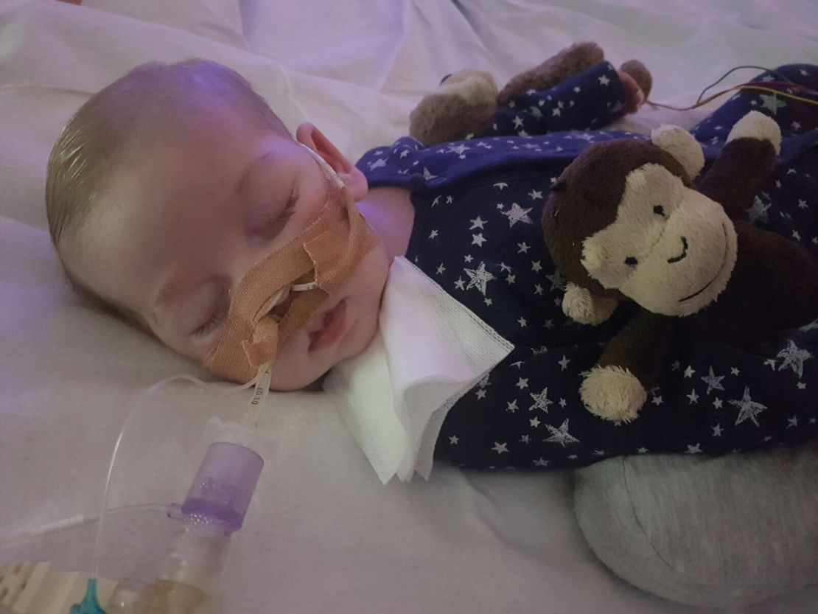
Potential Treatment: Nucleoside Bypass Therapy
A High Court ruling recommended that Charlie’s life support be stopped.
After the ruling, neurologist Dr Hirano offered to continue treatment in the US. Dr Hirano claimed there was a 10% chance that treatment could improve the baby’s condition – despite never meeting Charlie in-person.
Experts at Great Ormond Street Hospital feared the treatment wouldn’t help and would only prolong his suffering.

Slide 15
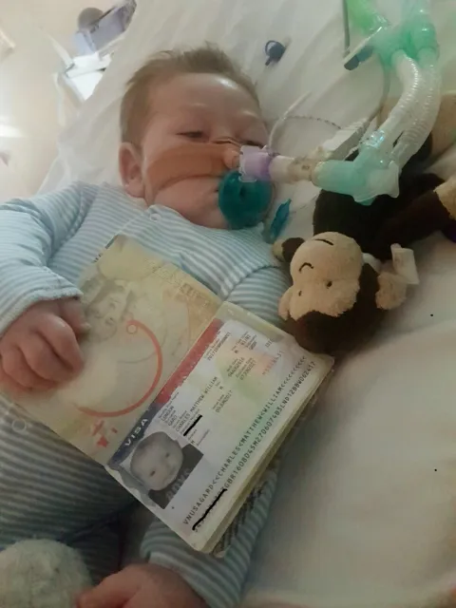
What was the treatment?
It’s called nucleoside bypass therapy. This explains more about the treatment.
It was untested on human or animals with RRM2B-related MDDS – but it has been shown to have some positive effects on test subjects with other mitochondrial conditions.
It had been used in 18 cases already – but Charlie’s condition was far more advanced.
All of the other cases involved people who suffered from a mutation in the TK2 gene, not the RRM2B gene, which is a different form of mitochondrial DNA depletion.
The patient must ingest compounds needed to develop new DNA strands which their body could not otherwise produce.
There was no evidence to suggest that the treatment would be able to cross the blood-brain barrier and resolve Charlie’s brain damage.

Slide 16
The Legal Battle To Continue Treatment
Charlie's parents accepted Dr. Hirano's treatment and appealed to stop cutting off life support until he was transferred to the United States, but the appeal was rejected before the Supreme Court and also the European Court of Human Rights, and the child died.

Slide 17
here are three key reasons why life-sustaining treatment is withheld or withdrawn:
The Ethical Dilemmas
1. Autonomy: A competent patient refuses it.
In Charlie’s case, his parents acted on his behalf due to his age and mental state.
2. Distributive justice: Expected benefit is insufficient to justify public resources being used
3. Treatment is not actually the best thing for the patient

Slide 18
our opinion
There was no evidence to suggest that the treatment would be able to cross the blood-brain barrier and resolve Charlie’s brain damage
Charlie suffered . It was impossible to tell if he was in pain and whether he was awake or asleep
the treatment wouldn’t help and would only prolong his suffering
Therefore, removing his life support is the best solution to relieve him of his suffering

Slide 19
Conclusion
Medical professionals frequently find themselves facing moral questions and ethical dilemmas in their line of work. Medical ethics provide a framework to help them make judgement calls which are morally sound and right for the patient in question.
It’s essential for aspiring Doctors to have a good moral compass and a solid grasp of medical ethics so they can consistently do what is best for their patients.

Slide 20
thank you for your attention

